Slide 1
Four Phases of Philosophy and its Present State
Barry Smith
Franz Brentano Centenary 1838–1917.
Program Vienna: Brentano and Austrian Philosophy
June 1-3, 2017

Slide 2
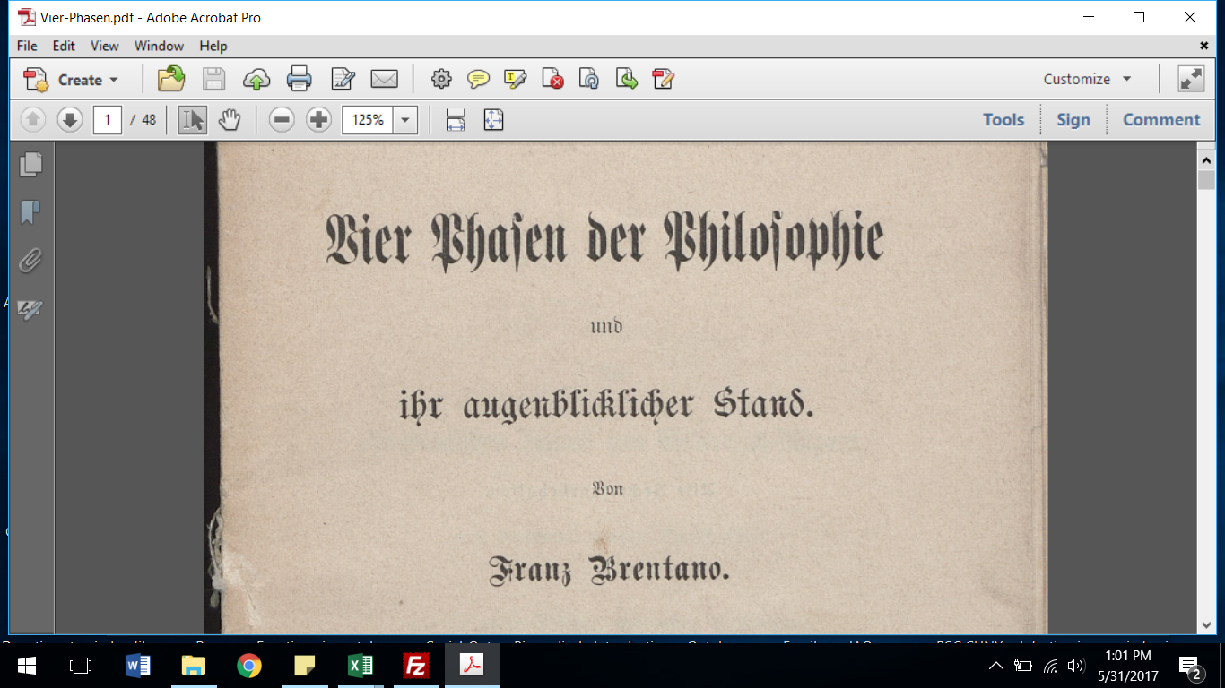

Slide 3
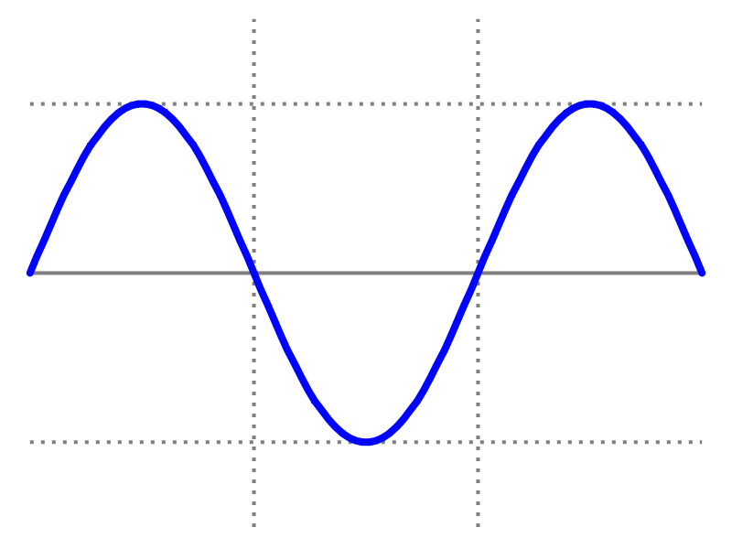
For Brentano, everything but the first phase is a phase of decline
rapid practical scepticism mystical
progress interest nonsense
Notes:
Über die Gründe der Entmuthigung auf philosophischem Gebiete

Slide 4
philosophy has passed, so far, through 4 cycles
rapid practical scepticism mystical
progress interest nonsense

Slide 5
up and down, up and down …
Ancient Medieval Modern 20th Century

Slide 6
up and down, up and down …
Ancient Medieval Modern 20th Century
1 2 3 4

Slide 7
First Cycle: Ancient
empirical
wonderment
Thales to Stoics and Pyrrhonists, Neo-Pythagoreans,
Aristotle Epicureans Eclectics Neo-Platonists

Slide 8
Second Cycle: Medieval
Aquinas
Augustine, Early Scotists Okham, Mystics,
Scholastics, Thomas Nominalists Cusa, Lull

Slide 9
Third Cycle: Modern
Bacon Enlightenment Hume Kant, Fichte
Descartes Reid Schelling
Locke, Leibniz Hegel

Slide 10
Fourth Cycle (Continental)
Brentano’s Husserl Heidegger Derrida and
rediscovery Reinach the French
of Aristotle Ingarden

Slide 11
Fourth Cycle (Analytic)
Frege Vienna Circle Wittgenstein 2º Rorty
Wittgenstein 1º Gödel Quine Feyerabend
Russell Tarski Goodman

Slide 12
But the move to practical relevance brings fruits of its own In the 3rd cycle: the empirical method, differential calculus, Cartesian coordinate system …
Bacon Practical
Descartes relevance
Leibniz, Locke
Newton

Slide 13
Philosophical mothership gives birth to empirical physics
Bacon Practical
Descartes relevance
Leibniz, Locke
Newton

Slide 14
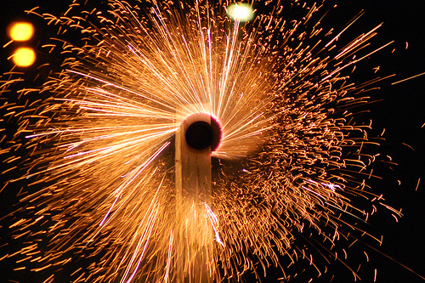
Notes:
http://bobmschwartz.com/2013/11/01/saints-for-all/

Slide 15
From here: Fourth Cycle (Continental)
Wundt
Brentano Husserl
Ehrenfels Bühler
Stumpf Lewin
Meinong Wertheimer

Slide 16
Philosophical mothership gives birth to the experimental psychology
Wundt
Brentano Husserl
Ehrenfels Bühler
Stumpf Lewin
Meinong Wertheimer

Slide 17
Birth of Psychology
1879: first psychological laboratory
1883: first psychology journal
1889: first International Congress of Psychology
1892: American Psychological Association

Slide 18
And from the Fourth Cycle (Analytic)
Frege Gödel
Leśniewski Tarski
Russell Turing

Slide 19
Philosophical mothership gives birth to mathematical logic and computer science
Frege Gödel
Leśniewski Tarski
Russell Turing

Slide 20
in each phase of practical relevance
some philosophers forsake philosophy to take part in establishing the methods, breadth, generalizability, and principles of the newly born science

Slide 21
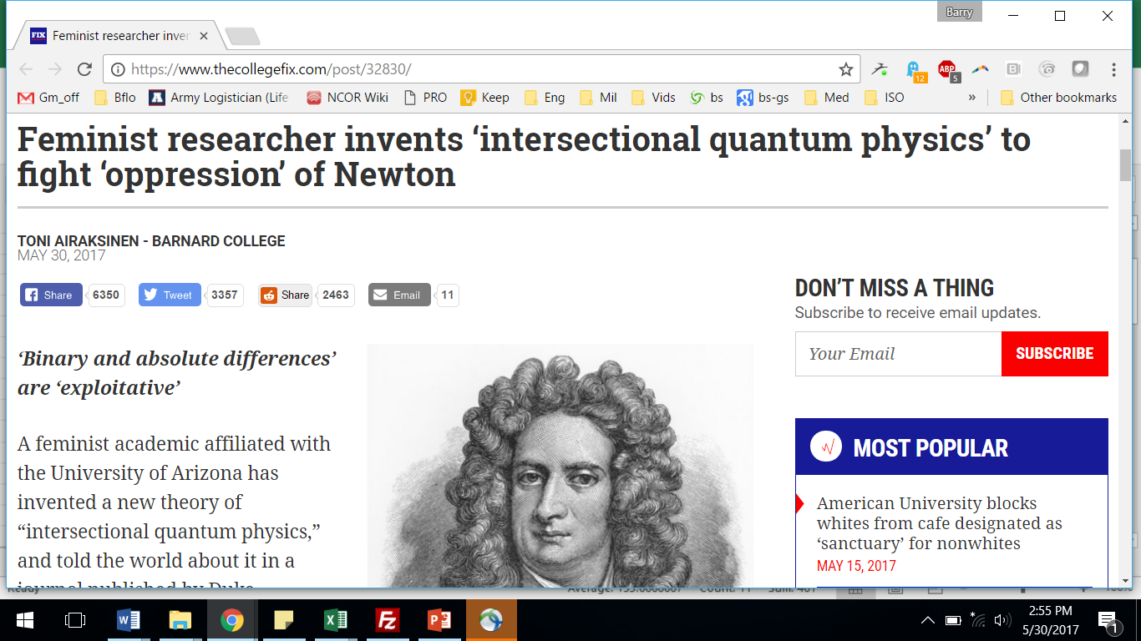
leaving philosophy itself in the safe hands of a new generation
Notes:
https://www.thecollegefix.com/post/32830/

Slide 22
leaving philosophy itself in the safe hands of a new generation
May 30, 2017
Notes:
https://www.thecollegefix.com/post/32830/

Slide 23
until the next final phase of decline collapses into nonsense and jokes, giving rise to the call for a new phase of renewal
Žižek
Badiou
Marion
Meillassoux

Slide 24
unser augenblicklicher Stand
Ancient Medieval Modern 20th Century
1 2 3 4 5

Slide 25
Fourth cycle (Continental)
Žižek
Badiou
Marion
Meillassoux

Slide 26
where shall our saviour come from?
Žižek
Badiou
Marion
Meillassoux

Slide 27
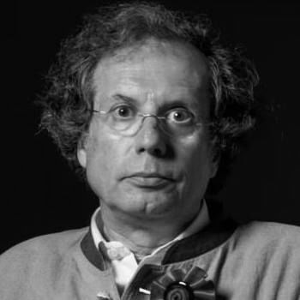

Slide 28
Maurizio Ferraris
Žižek
Badiou
Marion
Meillassoux

Slide 29
, proof of God’s existence

Slide 30

Photo
LabOnt
Ontologia del
Telefonino
The Ontology of the Mobile Phone

Slide 31
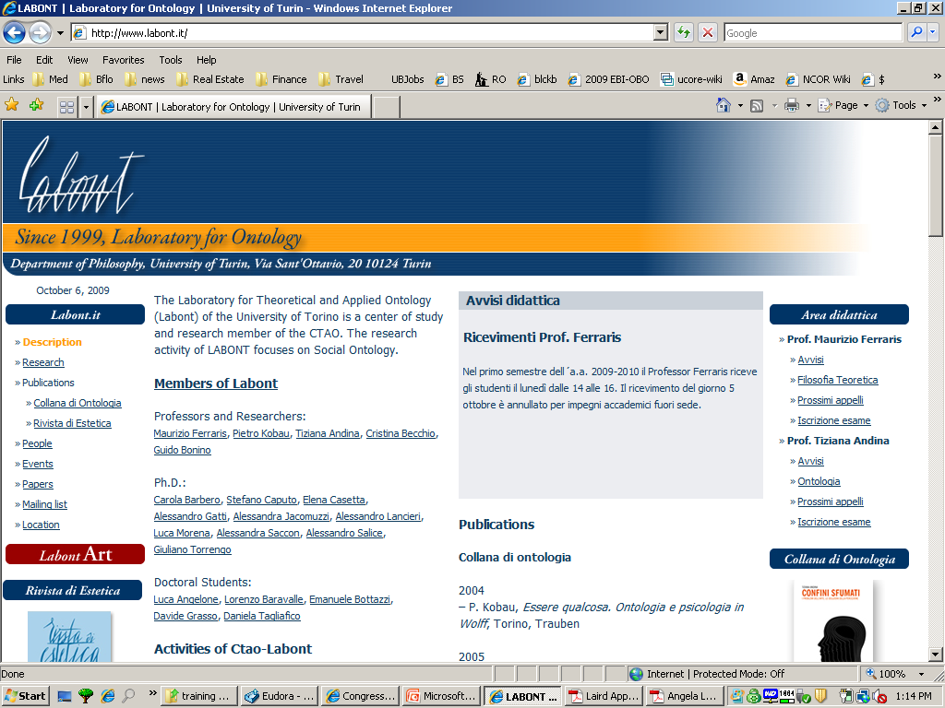
1999: Founding of LabOnt

Slide 32


Slide 33
or from here? Fourth Cycle (Analytic)
Frege
Russell
Tarski
Quine

Slide 34
or, better, from here? Fourth Cycle (Austro-Polish)
Husserl
Leśniewski
Ingarden
Tarski

Slide 35
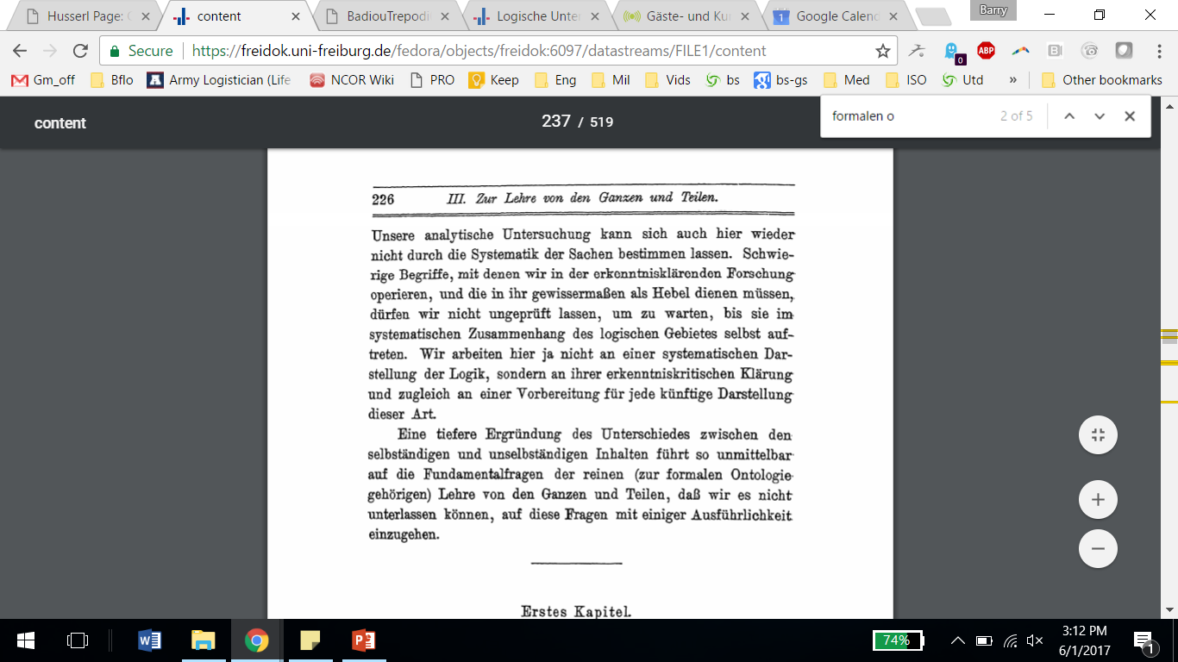
Husserl’s 3rd Logical Investigation

Slide 36
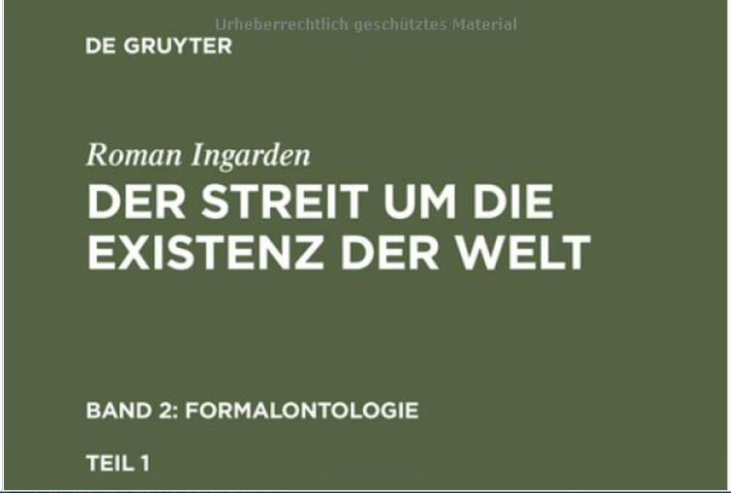

Slide 37
Philosophical mothership gives birth to new discipline of applied formal ontology
Husserl
Leśniewski
Ingarden
Tarski

Slide 38
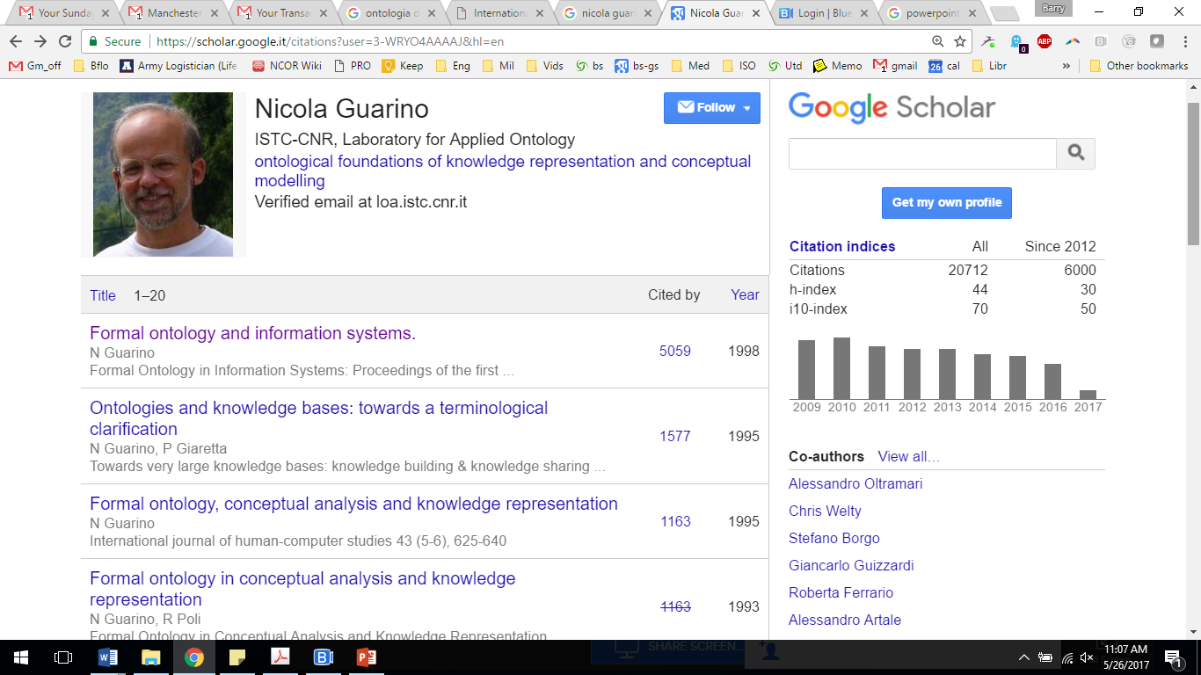
Nicola Guarino, Dr. Ing
Notes:
https://scholar.google.it/citations?user=3-WRYO4AAAAJ

Slide 39
Nicola Guarino, Dr. Ing
1991: LADSEB (Institute for Systems Dynamics and Biomedical Engineering, Padua) working group in applied formal ontology
Notes:
https://scholar.google.it/citations?user=3-WRYO4AAAAJ

Slide 40
Husserl’s 3rd Logical Investigation

Slide 41
Nicola Guarino, Dr. Ing
1991: LADSEB (Institute for Systems Dynamics and Biomedical Engineering, Padua) working group in applied formal ontology
1993: LADSEB fire
Notes:
https://scholar.google.it/citations?user=3-WRYO4AAAAJ

Slide 42
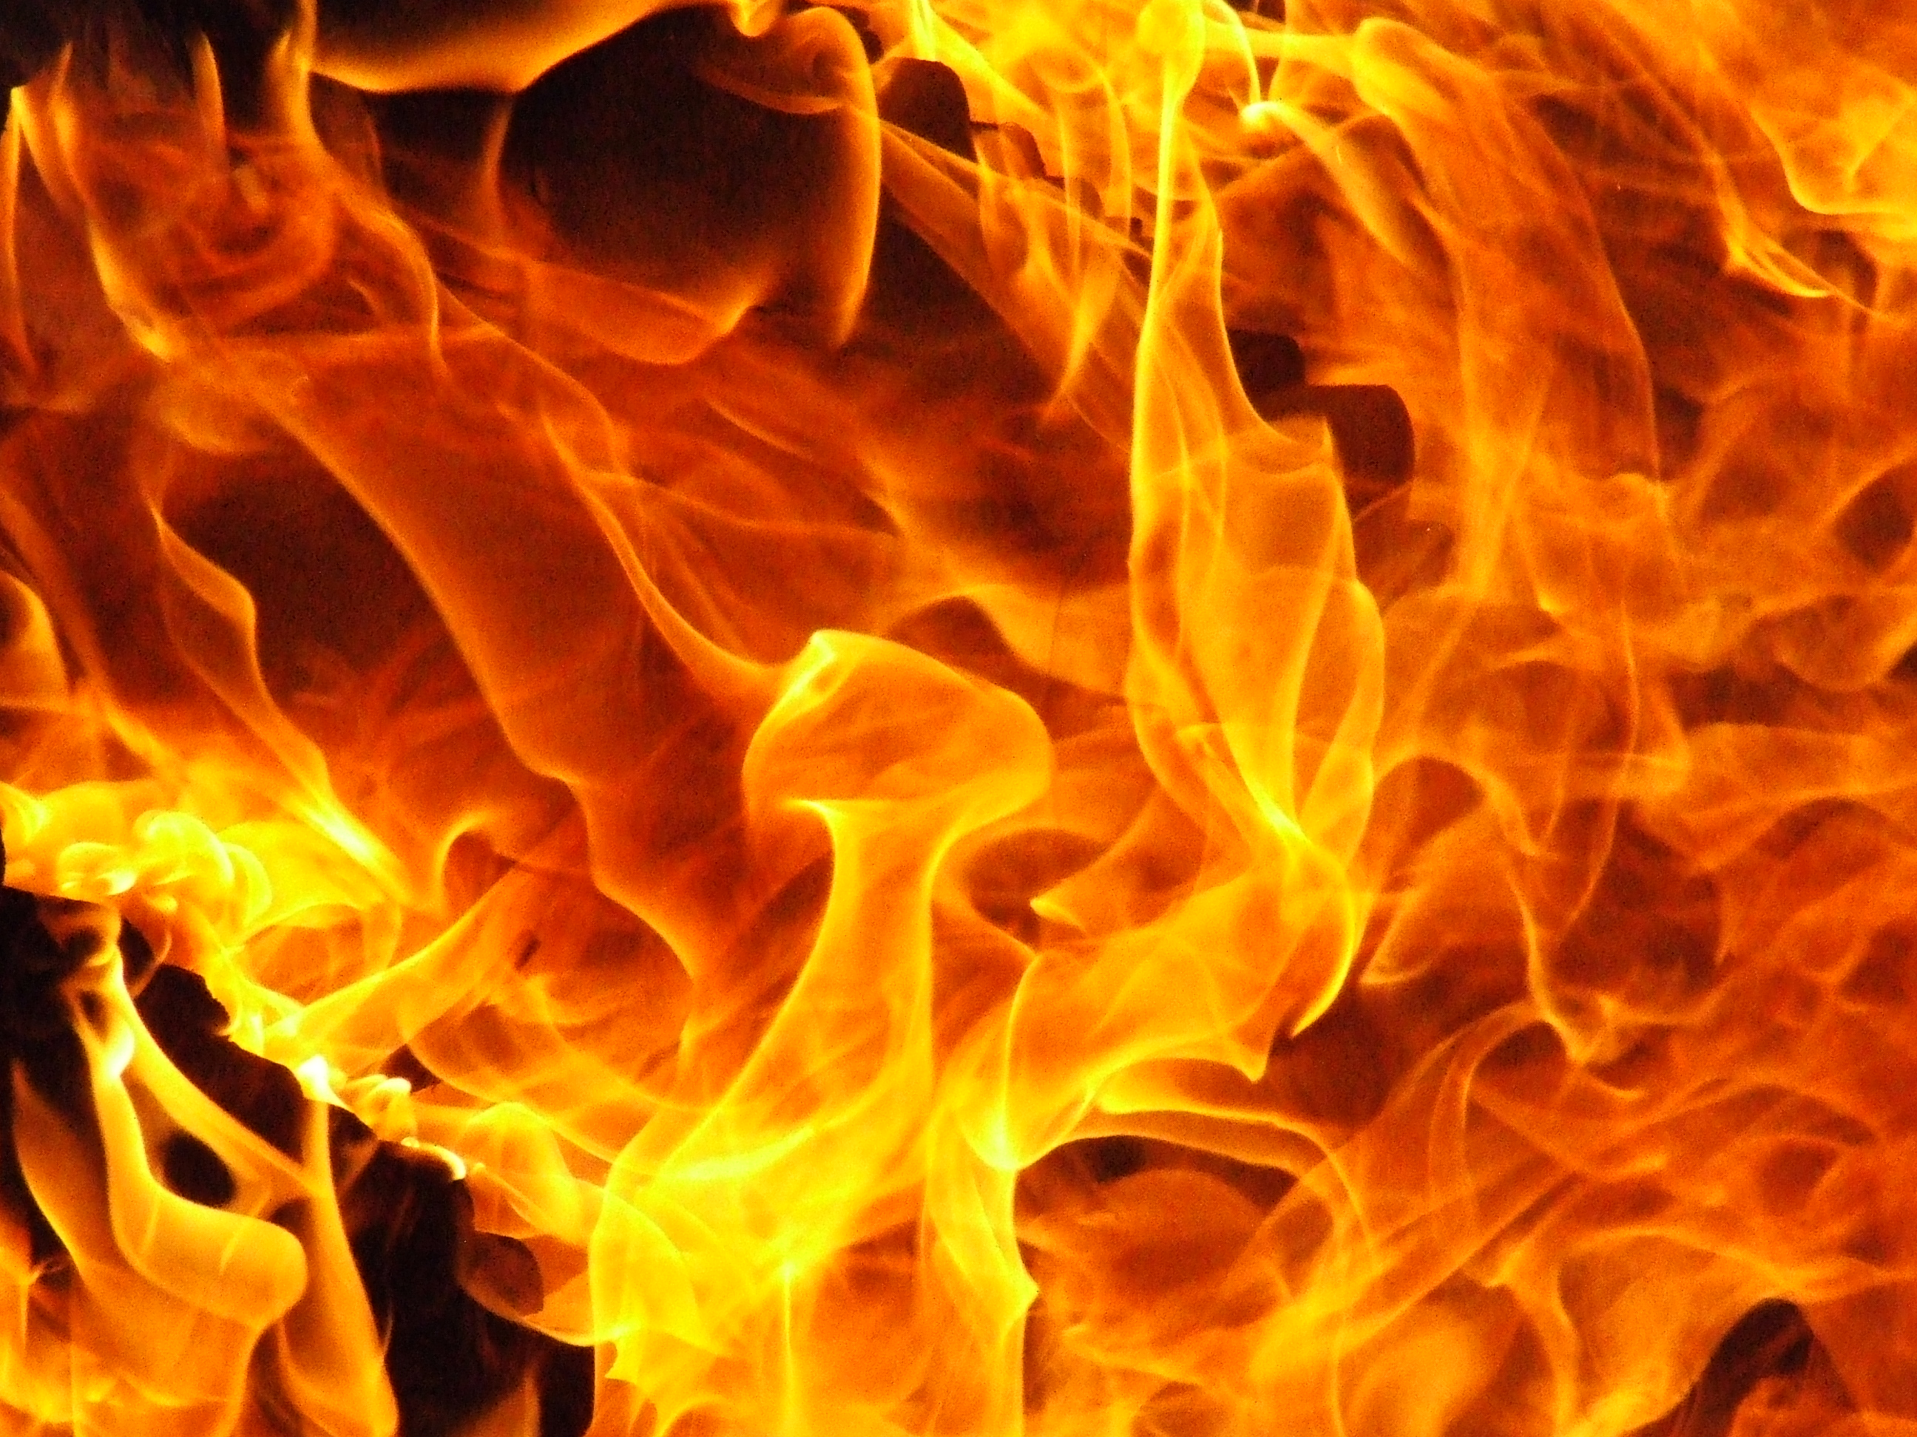

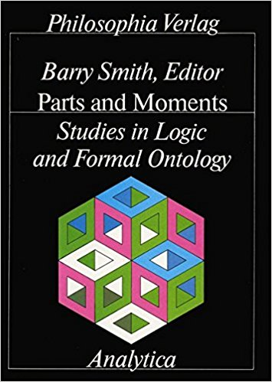
LADSEB Fire 1993
Parts and Moments Picture
Only two books survived

Slide 43
1993: International Workshop on Formal Ontology, LADSEB, Padua

Slide 44
1993: International Workshop on Formal Ontology, LADSEB, Padua
“Toward Principles for the Design of Ontologies Used for Knowledge Sharing”

Slide 45
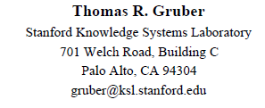
1993: International Workshop on Formal Ontology, LADSEB, Padua
“Toward Principles for the Design of Ontologies Used for Knowledge Sharing”

Slide 46
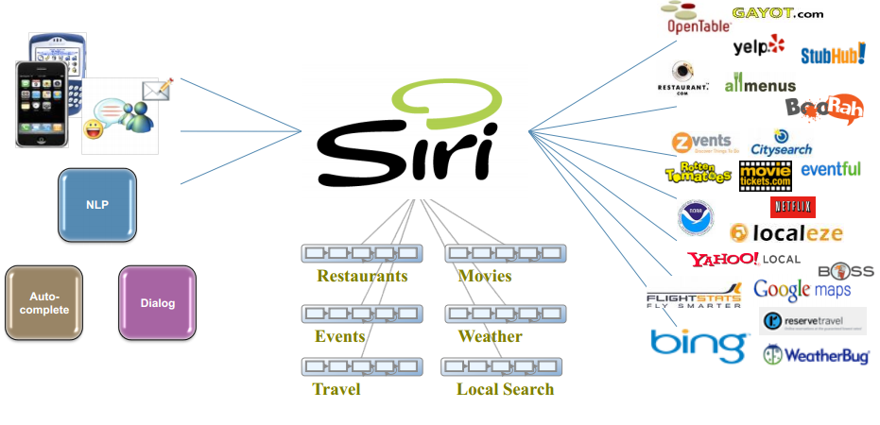
A. Cheyer and T. Gruber, “Siri: An Ontology-Driven Application for the Masses”
Notes:
http://ontolog.cim3.net/file/resource/presentation/Siri_20100225/Siri--An-Ontology-driven-Application-for-the-Masses--AdamCheyer-TomGruber_20100225.pdf

Slide 47
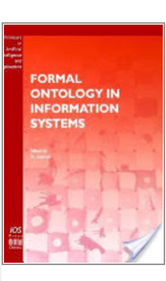
Formal Ontology in Information Systems: Proceedings of the First International Conference (FOIS 1998), Trento, Italy IOS Press

Slide 48






Formal Ontology in Information Systems, IOS Press
Notes:
2014, 2016

Slide 49
Formal Ontology in Information Systems, IOS Press
Applied Ontology
Journal of Biomedical Semantics
International Journal of Metadata, Semantics and Ontologies
Ontology Development and Applications
Journal of Social Ontology
Fundamenta Ontologica
Notes:
2014, 2016

Slide 50
Philosophical mothership gives birth to new discipline of applied formal ontology
Husserl
Leśniewski
Ingarden
Tarski
John McCarthy
Patrick Hayes
Thomas Gruber

Slide 51
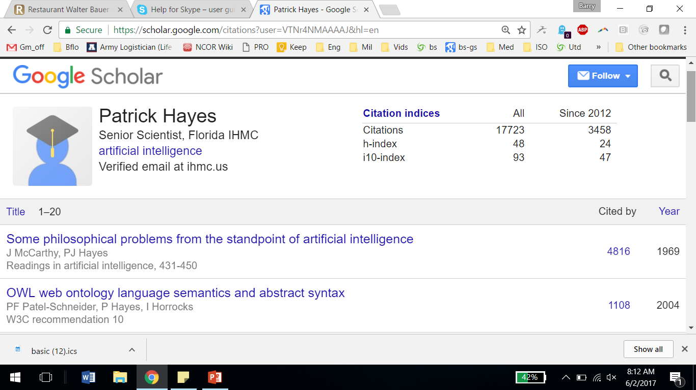
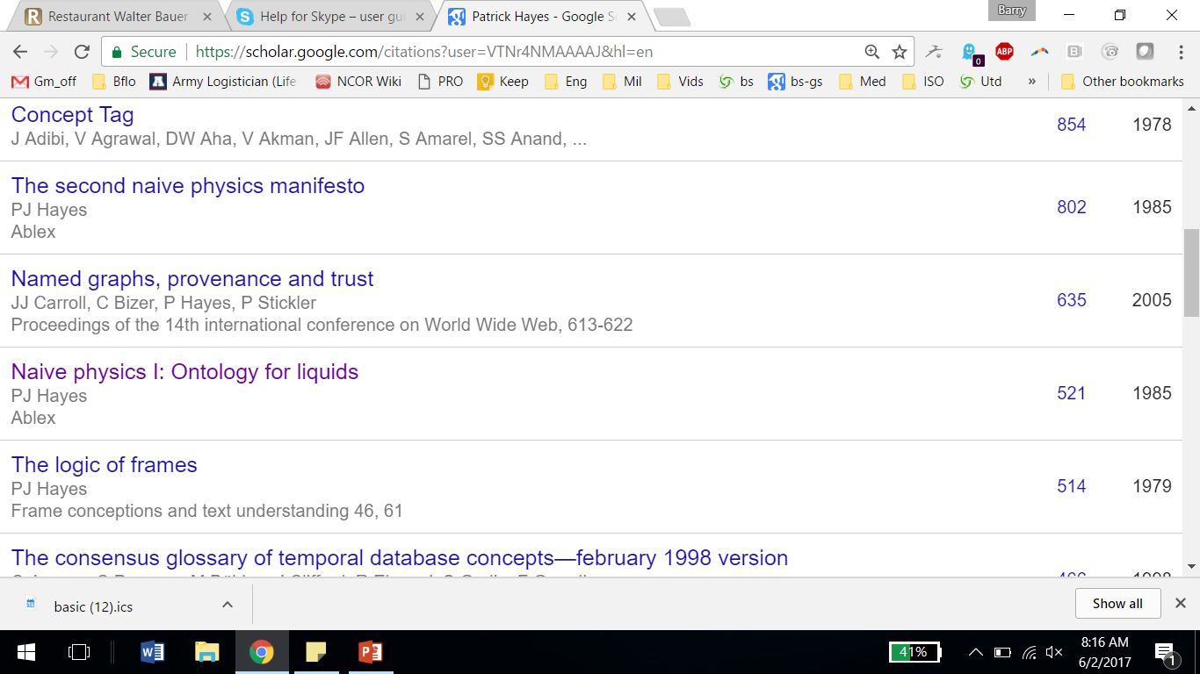

Slide 52

1985

Slide 53
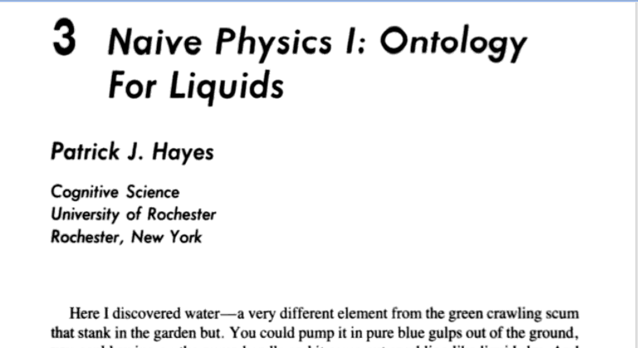
first version, Geneva: 1978

Slide 54
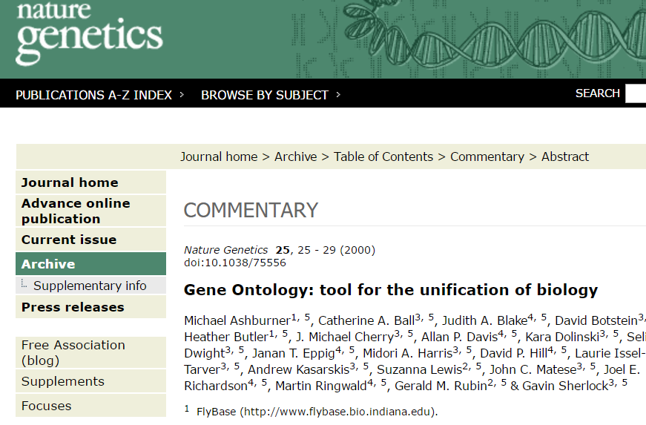
Nature Genetics 25, 25 - 29 (2000)
doi:10.1038/75556
Gene Ontology: tool for the unification of biology
http://geneontology.org/ 1998

Slide 55
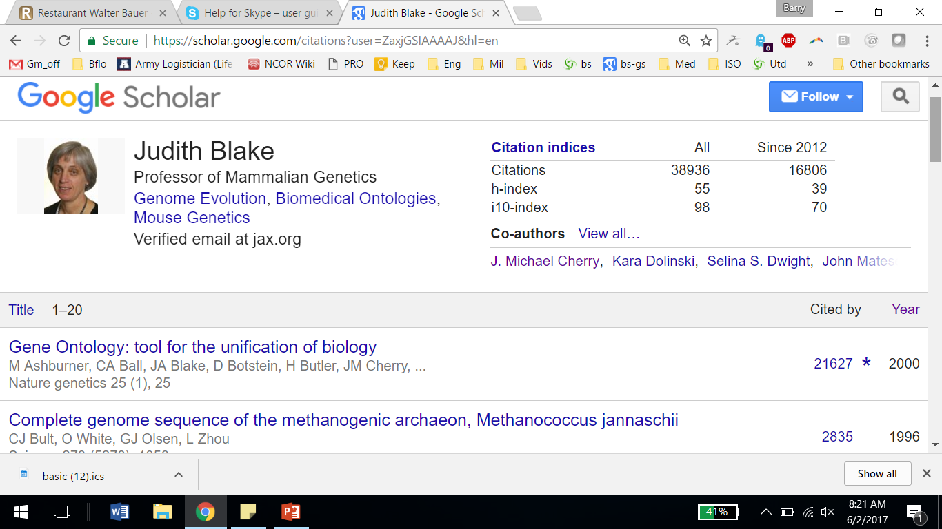

Slide 56
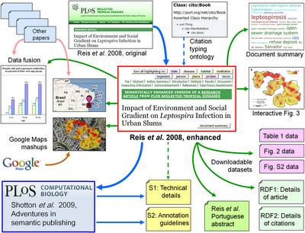
Notes:
Roderic Page: Semantic Publishing
http://iphylo.blogspot.co.uk/2009/04/semantic-publishing-towards-real.html

Slide 57
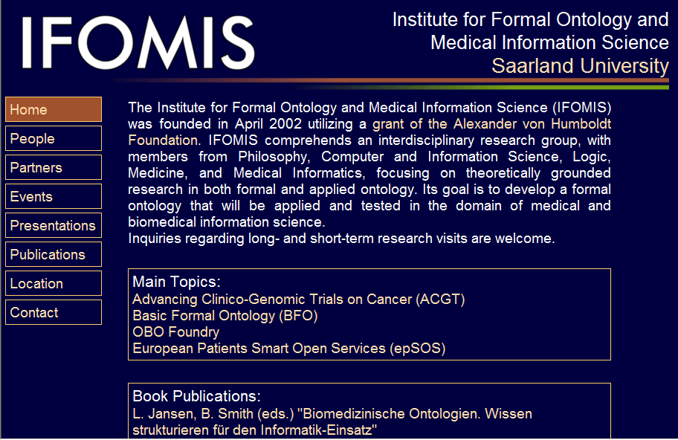
2002 Founding of IFOMIS
Founded 2002

Slide 58
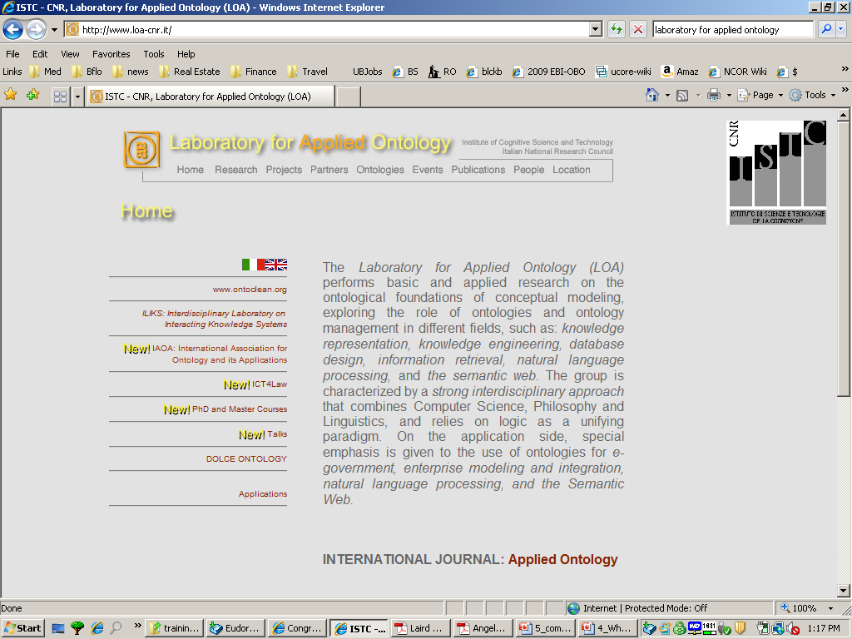
2003: Founding of LAO

Slide 59
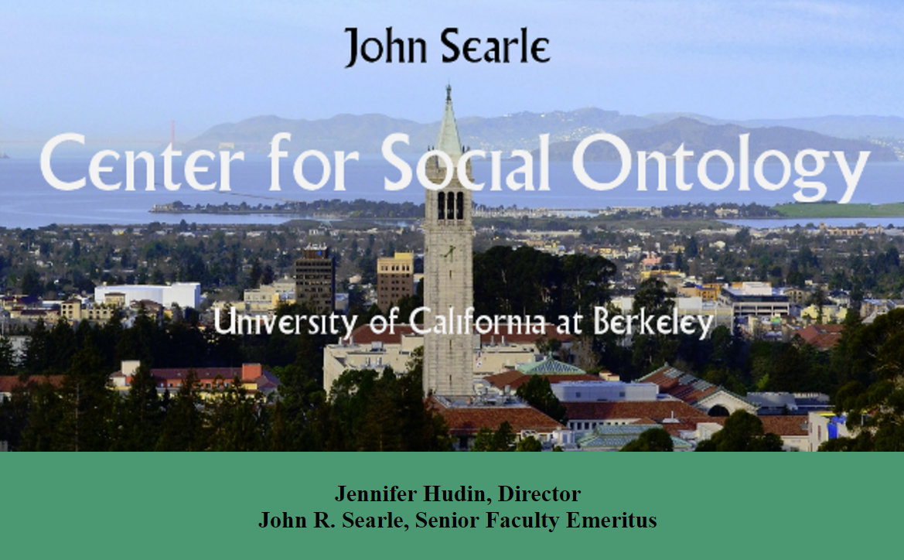
Founded 2016: JSCSO

Slide 60
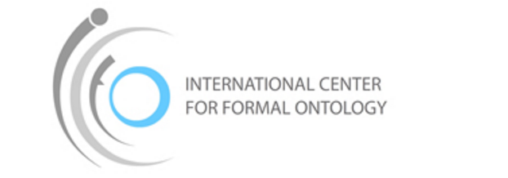
2015: Founding of ICFO
International Center for Formal Ontology, Warsaw
established to inspire and focus thought on philosophical and non-philosophical issues requiring ontological considerations with formal methods and associated formalized description languages. ICFO strives to follow the tradition of the Lvov-Warsaw Philosophical School.
Notes:
http://www.icfo.ans.pw.edu.pl/en/?page_id=1493

Slide 61
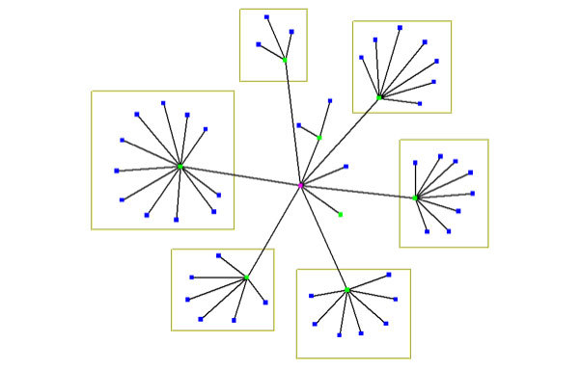
hub and spokes strategy for ontology development

Slide 62
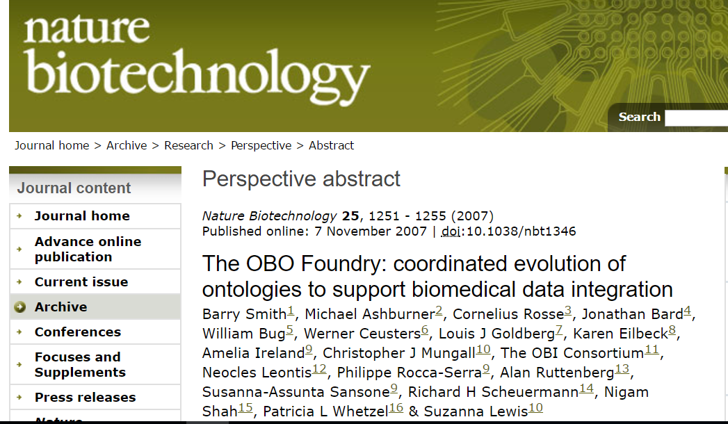
Nature Biotechnology 25, 1251 - 1255 (2007)
Published online: 7 November 2007 | doi:10.1038/nbt1346
The OBO Foundry: coordinated evolution of ontologies to support biomedical data integration
2007

Slide 63
top level
mid-level
domain level
Basic Formal Ontology (BFO)
Information Artifact Ontology (IAO) | Ontology for Biomedical Investigations (OBI) | Spatial Ontology (BSPO)
Anatomy Ontology (FMA*, CARO) |  | Environment Ontology (EnvO) | Infectious Disease Ontology (IDO*) | Biological Process Ontology (GO*)
Cell Ontology (CL) | Cellular Component Ontology (FMA*, GO*)
 |  |  | Phenotypic Quality Ontology (PaTO)
Subcellular Anatomy Ontology (SAO)
Sequence Ontology (SO*) |  |  | Molecular Function (GO*)
Protein Ontology (PRO*)
OBO Foundry Modular Organization
Notes:
* = dedicated NIH funding

Slide 64
Basic Formal Ontology (BFO)
a small upper-level ontology designed to support consistent sharing of data drawing on Aristotle, Husserl, Ingarden
containing terms such as:
object quality
processs process boundary
temporal point temporal interval
disposition function

Slide 65
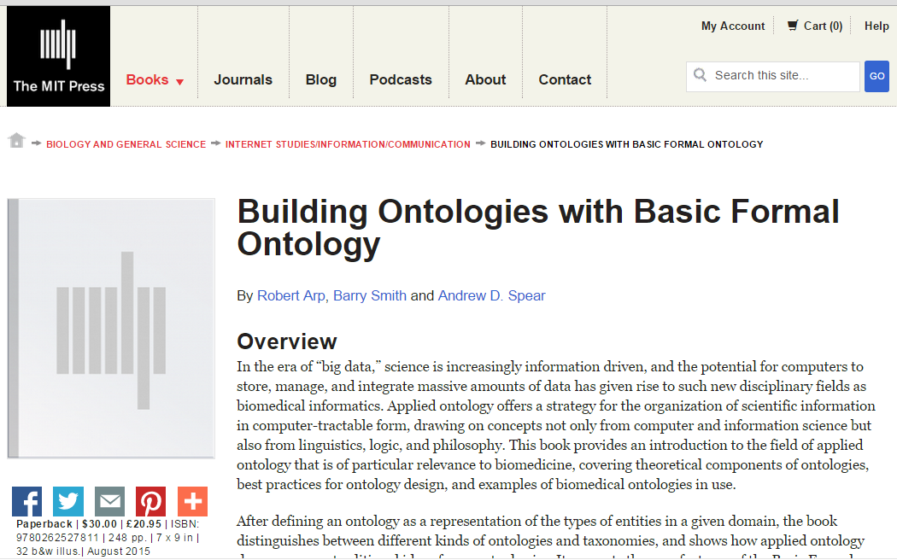
http://ontology.buffalo.edu/BOBFO
http://mitpress.mit.edu/building-ontologies

Slide 66
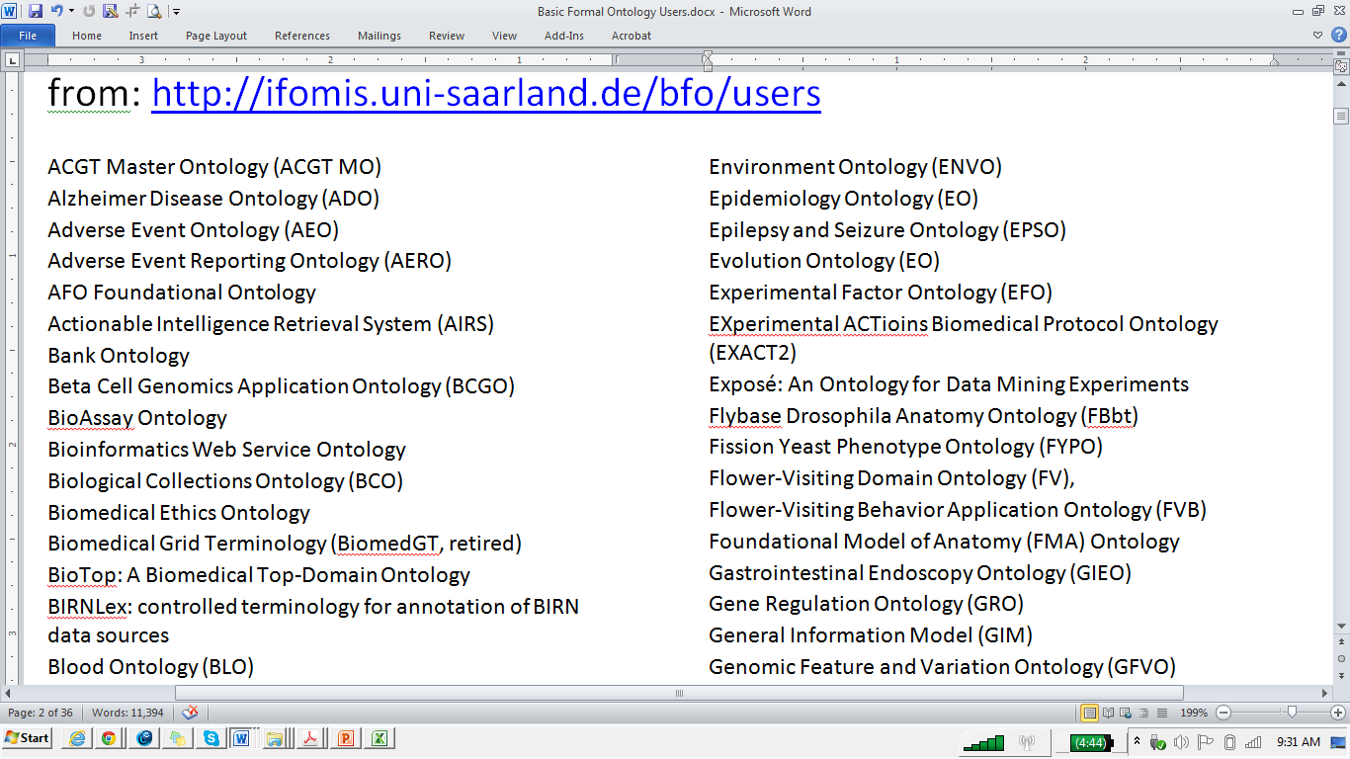
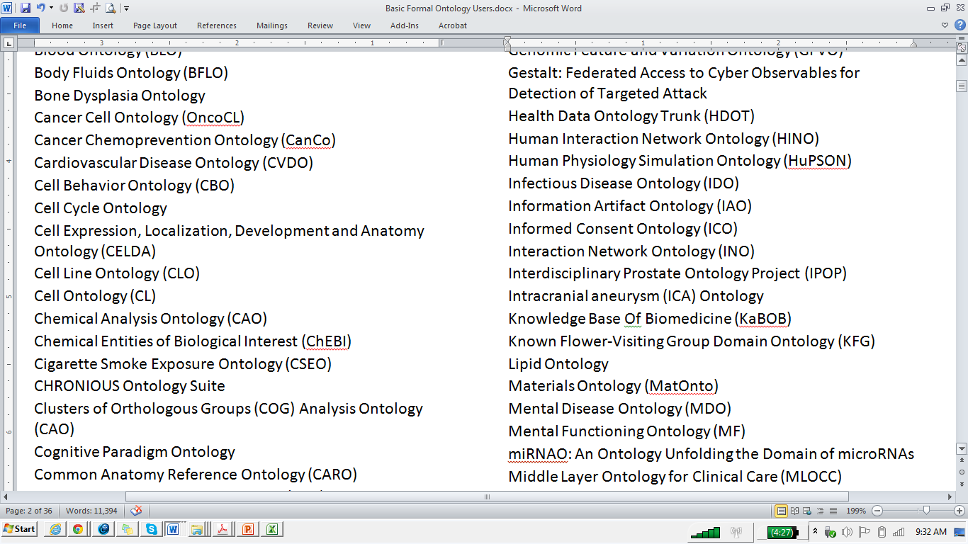
~ 300 ontologies re-using BFO

Slide 67
examples of the hub-and-spokes strategy applied
NIF Standard | Neuroscience Information Framework
eagle-I | Integrated Semantic Framework / CTSA Connect
cROP / Planteome | Common Reference Ontologies for Plants
UNEP Ontology Framework | United Nations Environment Programme
USGS National Map Ontologies | United States Geological Survey
TRIP Ontologies | Federal Highway Administration (FHWA) Transportation Research Informatics Platform (TRIP)

Slide 68
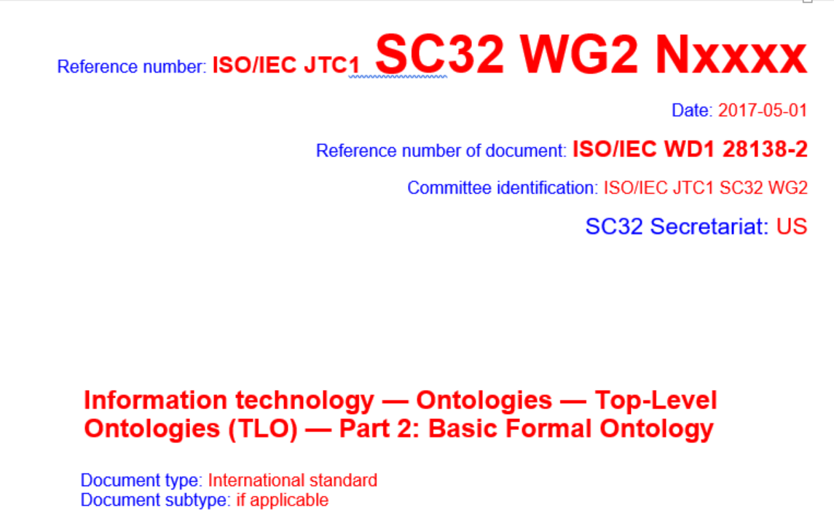
ISO standard
ISO (International Standards Organization) Working draft

Slide 69
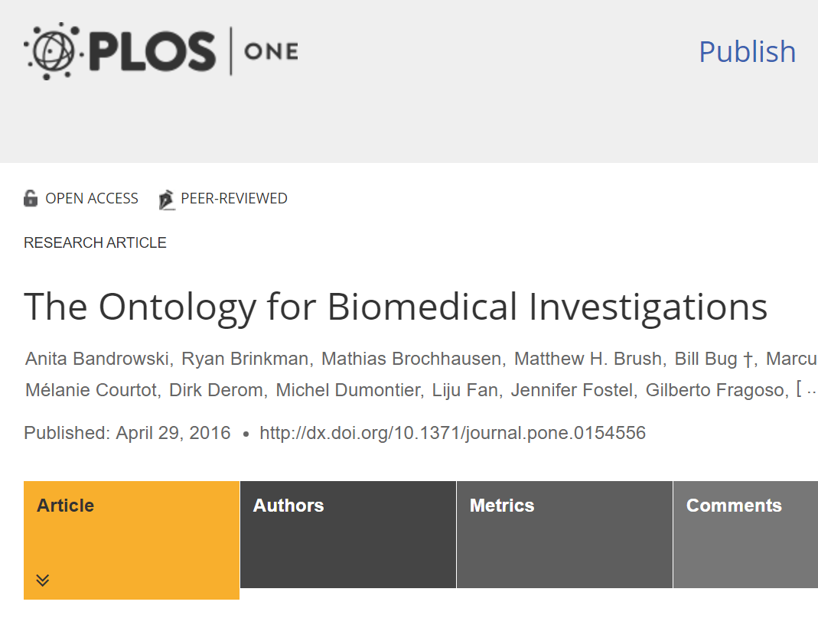
Notes:
http://journals.plos.org/plosone/article?id=10.1371/journal.pone.0154556

Slide 70
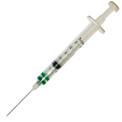

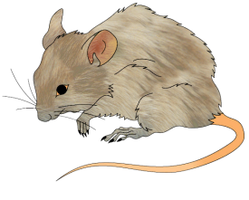
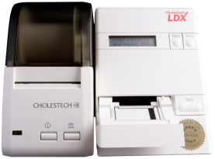

Representing an experimental assay in OBI
Measure Function
Process: Collecting specimen from organism
is realized by
inheres in
Glucometer
Process: Analyte assay
Measurement Datum
1.2 mg/ml
has specified input
has specified input
has specified output
has specified input
has specified input
has specified output
inheres in
located in
is realized by
Specimen Role
is realized by
is realized by
Analyte Role
Glucose molecules
Blood Specimen
Evaluant Role
inheres in
part of
inheres in

Slide 71
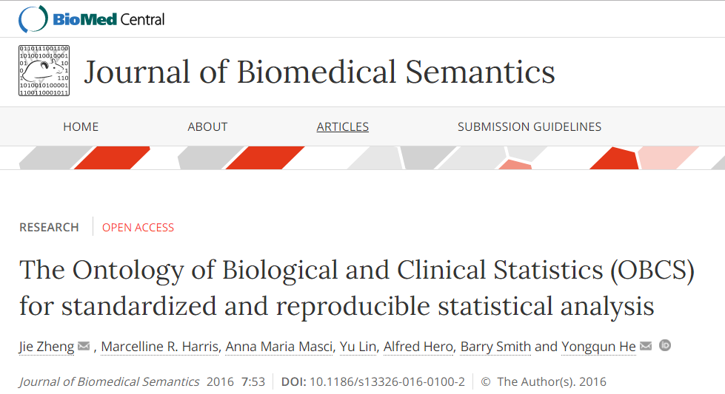
The Ontology of Biological and Clinical Statistics (OBCS) for standardized and reproducible statistical analysis
Jie ZhengEmail author,
Marcelline R. Harris,
Anna Maria Masci,
Yu Lin,
Alfred Hero,
Barry Smith and
Yongqun He
Addressing the problem of replication

Slide 72
BFO: continuant
BFO: occurrent
is a
is a
is a
BFO: Generically Dependent continuant
BFO: Object
BFO:Process
is a
is a
is a
CCO: Artifact
CCO: Intention Act
is a
CCO: Information Content Entity
PLC: Product
is a
PLC: Act of Production
Notes:
Here is a diagram showing that an inflation device produced by Cobham was X-rayed during a sample check. The X ray is performed to ensure there are not cracks or bubbles internal to the body of the device. In this instance, the inflation device passed the radiographic exam. [Note: The prefixes included in the universal nodes here include the PLC (product life cycle), CCO (common core ontologies), the CHAMP (formerly referred to as the FLU12 ontology), and of course BFO. ]

Slide 73
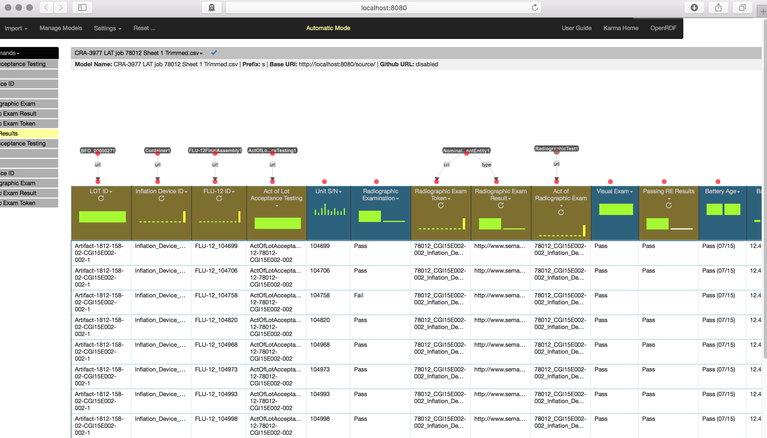
Notes:
Data Alignment uses OSCAR (a proprietary improvement on KARMA). This tool imports OWL and CSV files and allows users to create and export mappings, as well as to generate and export RDF. Here we see from the previous slide the radiographic exam, as well as instances of the act that produced them, the inflation device that participates in them, and the acts. Some of these columns were created by using python to transform or supplement the original columns in the CSV file. There are then some preliminary mappings that appear on top of the columns, displaying column URIs.

Slide 74
Notes:
Data Alignment uses OSCAR (a proprietary improvement on KARMA). This tool imports OWL and CSV files and allows users to create and export mappings, as well as to generate and export RDF. Here we see from the previous slide the radiographic exam, as well as instances of the act that produced them, the inflation device that participates in them, and the acts. Some of these columns were created by using python to transform or supplement the original columns in the CSV file. There are then some preliminary mappings that appear on top of the columns, displaying column URIs.

Slide 75
Notes:
Data Alignment uses OSCAR (a proprietary improvement on KARMA). This tool imports OWL and CSV files and allows users to create and export mappings, as well as to generate and export RDF. Here we see from the previous slide the radiographic exam, as well as instances of the act that produced them, the inflation device that participates in them, and the acts. Some of these columns were created by using python to transform or supplement the original columns in the CSV file. There are then some preliminary mappings that appear on top of the columns, displaying column URIs.

Slide 76
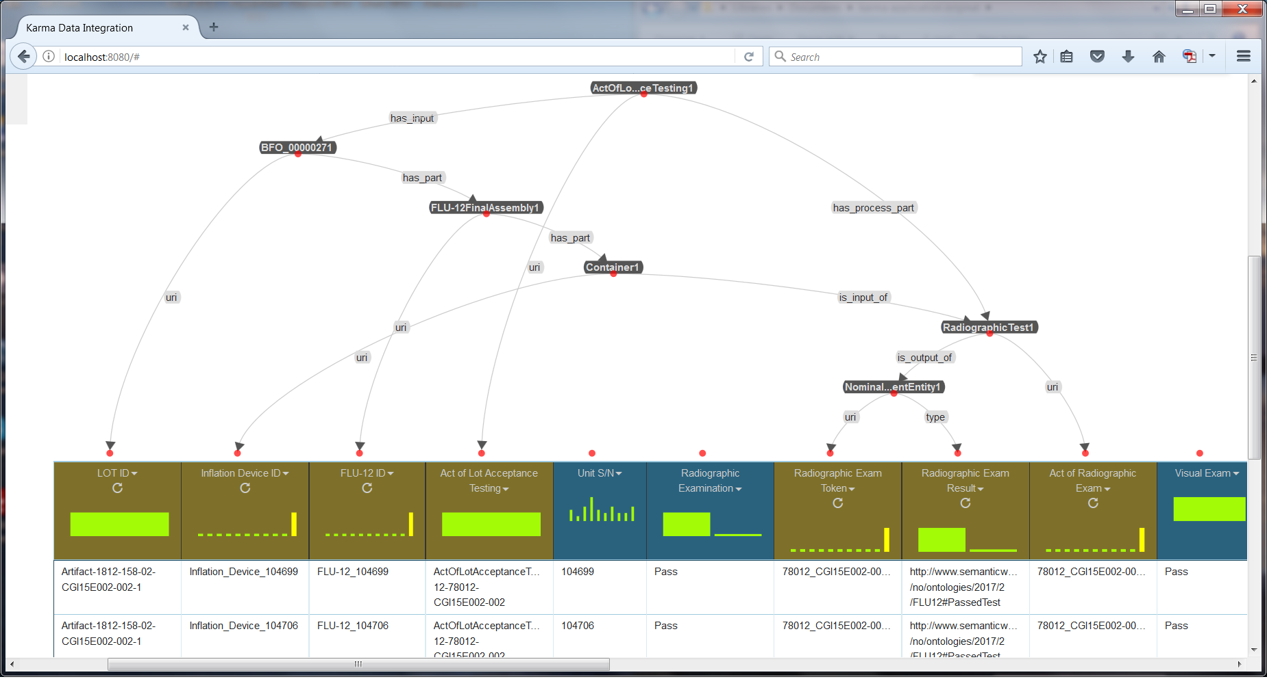
data

Slide 78
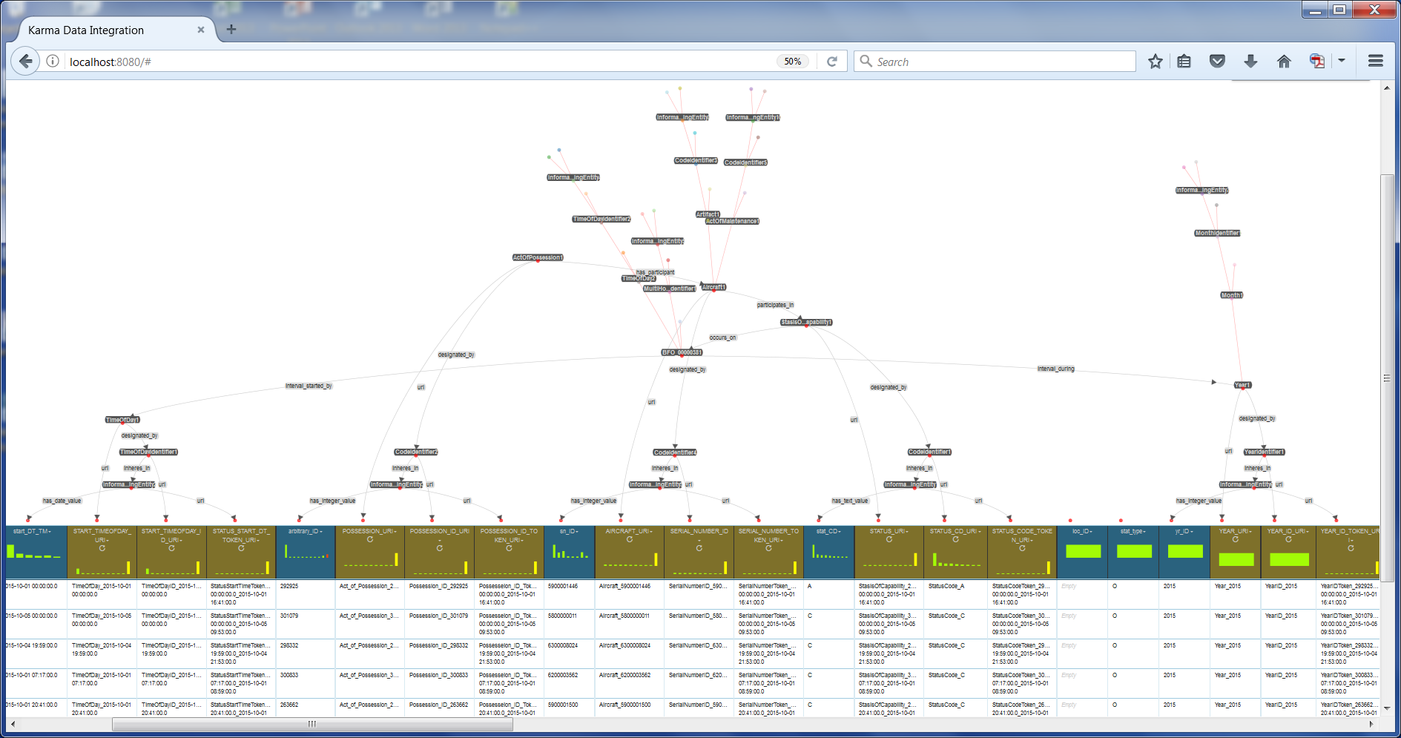

Slide 79
BFO: continuant
BFO: occurrent
is a
is a
is a
BFO: Generically Dependent continuant
BFO: Object
BFO:Process
is a
is a
is a
CCO: Artifact
CCO: Intention Act
is a
CCO: Information Content Entity
PLC: Product
is a
PLC: Act of Production
Notes:
Here is a diagram showing that an inflation device produced by Cobham was X-rayed during a sample check. The X ray is performed to ensure there are not cracks or bubbles internal to the body of the device. In this instance, the inflation device passed the radiographic exam. [Note: The prefixes included in the universal nodes here include the PLC (product life cycle), CCO (common core ontologies), the CHAMP (formerly referred to as the FLU12 ontology), and of course BFO. ]

Slide 80
BFO: continuant
BFO: occurrent
Particulars
is a
is a
is a
Universals
BFO: Generically Dependent continuant
BFO: Object
BFO:Process
is a
is a
is a
CCO: Artifact
CCO: Intention Act
instance of
is a
CCO: Information Content Entity
PLC: Product
is a
instance of
PLC: Act of Production
instance of
Inflation Device
instance of
participates in
Nominal Measurement Information Content Entity
Act of Lot Acceptance Testing
inheres in
Information Content Entity Bearer
instance of
has text value
participates in
Act of Radiographic Exam
xsd: “Pass”
has output
Notes:
Here is a diagram showing that an inflation device produced by Cobham was X-rayed during a sample check. The X ray is performed to ensure there are not cracks or bubbles internal to the body of the device. In this instance, the inflation device passed the radiographic exam. [Note: The prefixes included in the universal nodes here include the PLC (product life cycle), CCO (common core ontologies), the CHAMP (formerly referred to as the FLU12 ontology), and of course BFO. ]

Slide 81
Google hits 2004
ontology + Heidegger 58K
ontology + Aristotle 77K
ontology + philosophy 327K

Slide 82
Google hits 2004
ontology + Heidegger 58K
ontology + Aristotle 77K
ontology + philosophy 327K
ontology + software 468K
ontology + database 594K

Slide 83
Comparison 2004 2017
ontology + Heidegger 58K 414K
ontology + Aristotle 77K 439K
ontology + philosophy 327K 872K

Slide 84
Comparison 2004 2017
ontology + Heidegger 58K 414K
ontology + Aristotle 77K 439K
ontology + philosophy 327K 872K
ontology + software 468K 10.2M
ontology + database 594K 16.8M

Slide 85
Comparison 2004 2017
ontology + Heidegger 58K 414K
ontology + Aristotle 77K 439K
ontology + philosophy 327K 872K
ontology + software 468K 10.2M
ontology + database 594K 16.8M

